Slide 1
AVL Trees

Slide 2
Definition
Balanced trees
Tree with n nodes has height O(log n)
AVL tree
|h(v->left)-h(v->right)|≤1 for all nodes v
Examples
F0, F1
Counter examples

Slide 3
AVL Trees are Balanced I
The family F_{h} is defined inductively
First two trees – F₀ and F₁
F_{i+1} – root with F_{i-1} as left sub-tree, F_{i} right sub-tree
Claim: F_{h} is an AVL tree and has height h
Claim: F_{h} has the least number of nodes of all AVL trees of height h
Recall: Fibonacci numbers: f₀=0, f₁=1, f₂=1, f₃=2, f₄=3, f₅=5, f₆=8,…,f_{i+1}=f_{i-1}+f_{i}
Claim: The number of nodes in F_{i} is ≥ f_{i+2}

Slide 4
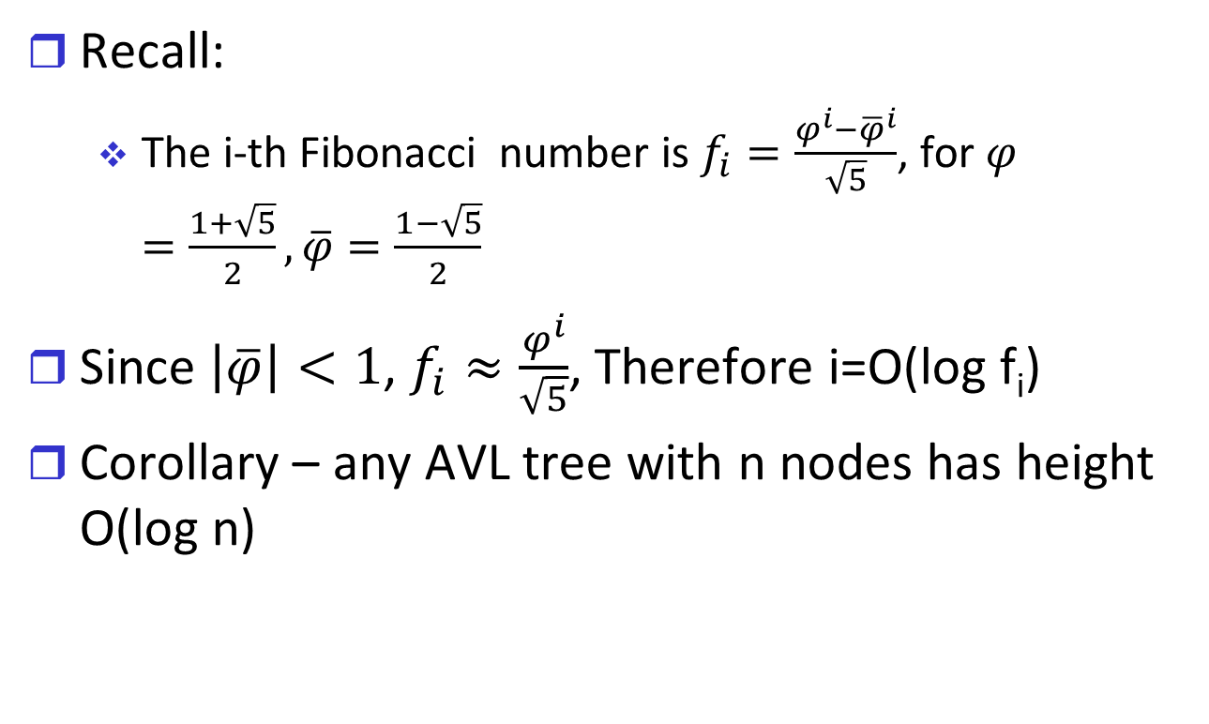
AVL Trees are Balanced II
Recall:
The i-th Fibonacci number is $f_{i}=\frac{φ^{i}−{\overline{φ}}^{i}}{\sqrt{5}}$, for $φ=\frac{1+\sqrt{5}}{2}, \overline{φ}=\frac{1−\sqrt{5}}{2}$
Since $\left|\overline{φ}\right|<1$, $f_{i}≈\frac{φ^{i}}{\sqrt{5}}$, Therefore i=O(log f_{i})
Corollary – any AVL tree with n nodes has height O(log n)

Slide 5
Maintaining AVL Trees
Challenge: maintain AVL property after insertion, deletion
Balancing Factor stored in v
BF=|h(v->left)-h(v->right)|, legal values {-1, 0, 1}
Insert(v) has three options
Does not change height of any node
Changes height of node on path to new leaf, but AVL property holds
For some v AVL property does not hold
|Height(v->left)-height(v->right)|=2
v must be on path from root to new leaf

Slide 6
Rotations: Correcting Insertions (LL)
v
u
v_{r}
h
u_{l}
u_{r}
h-1
x
Height(v)=h+1 before insertion
Height(v)=h+2 after insertion

Slide 7
Rotations: Correcting Insertions (LL)
u
v
u_{l}
u_{r}
v_{r}
h
h
x
Height(v)=h+2 before rotation
Height(v)=h+1 after rotation

Slide 8
Rotations: Correcting Insertions (LR)
v
u
v_{r}
h
u_{l}
w
h-1
w_{l}
w_{r}
h-2
x
Height(v)=h+1 before insertion
Height(v)=h+2 after insertion

Slide 9
Rotations: Correcting Insertions (LR)
w
u
v
h
u_{l}
w_{l}
w_{r}
v_{r}
h
x
Height(v)=h+2 before rotation
Height(v)=h+1 after rotation

Slide 10
Insertion in AVL Tree
Insert new node as in binary search tree
From new leaf to root
Update balancing factor
Check if legal
If not – correct by rotation
After insertion at most single rotation
Height of tree before insertion = height after rotation
Complexity – O(log n)

Slide 11
Deletion in AVL Tree
Delete as in binary search tree
On path from deleted node to root check for invalid balancing factor
Imbalance can be fixed by one of LL, LR, RL, RR
Height at fixed node may change ➔ fix whole path
Complexity – O(log n)

Slide 12
Rank Tree
DS with
Operations of search tree (insert, delete, search,…)
Rank (x) – return rank (order statistic) of node x
Reverse rank (i) – return node with i-th rank
Store N(v) in each node v
N(v) – number of nodes in sub-tree of v
Compute rank(x) by
Rank←0
Traverse path from root to x
For every right turn from v, Rank←Rank+1+N(v->left)

